Slide 1
Module 7: Optimizing Site Performance
Notes:
Instructor notes:
This title slide introduces the name of the course.
The targeted duration of the course would let the target audience know about the length of the course.

Slide 2

Module Objectives
In this lesson, you will optimize the performance
of a site.
You will:
  Enhance bean-level performance.
  Enhance database-level performance.
Notes:
Instructor’s Notes:
You have worked with EJB Query Language for obtaining required data from a database.
Additionally, you have identified instances in your application plan where only a messagedriven
bean will help achieve the functionality you are looking for. In this lesson, you will
develop message-driven beans and incorporate them in your application.
Using message-driven beans in your application is like registering your mobile phone with a
service provider. Once your mobile number is registered, you can use services such as messaging,
Internet access, and voice mail. Similarly in Java, you are able to send or receive
messages across multiple servers and clients, but only when your message-driven bean is properly
configured and incorporated.
In this lesson, you will develop message-driven beans.
You will:
Examine a JMS application.
Create a message-driven bean class.
Create a client class for a message-driven bean.
Call an EJB from another EJB.
Establish communication between the EJBs
and an HTML front-end.

Slide 3
Module Content Duration
Topic A: Enhance Bean-Level Performance
Topic B: Enhance Database-Level Performance
Notes:
Instructor notes:
On the Agenda slide you are introducing a high level overview of the training course. It is to establish a framework of expectations, not focus on all the details that will come. So identify only the modules or the main topics, not all the sub-topics.

Slide 4
Enhance Bean-Level Performance
Business Entity Identification
Network Overheads Minimization
Local and Remote Interfaces
Return Entity Data from EJBs
Notes:
Instructor notes:
The Agenda slide should show the main topics to be covered in the module.
Topic title slides, based on the agenda, are used to “storyboard” the presentation.
See subsequent pages of this template for Topic title slides

Slide 5
Topic A: Enhance Bean-Level Performance
As different types of beans are used in an application, enhancing bean-level performance is important.
In this topic, you will:
  Identify the various components in the application following the general guidelines for fine-tuning an EJB application
  Be able to fine-tune the site
  Be able to minimize the constraints in your application
  Be able to optimize its performance
Notes:
Instructor notes:
The introduction provides a definition/value statement that sets the context of the topic for the learner.
Remember that bullets are square and light blue, not black

Slide 6
Business Entity Identification
The various business entities that the application needs to represent need to be identified before development commences. This is revised several times to ensure that only those entities that are absolutely needed are included. This ensures optimum use of memory and also saves precious development time. Subsequently, the entities that need to be implemented as EJBs and the type of beans to use is decided.

Slide 7
Network Overheads Minimization
When an entity bean is called from a java swing, JSP, or a servlet, it creates a substantial number of network calls, thus increasing network overheads. This is solved by wrapping a number of entity beans in one session bean. The session bean makes a single remote call, gets the requests, and processes all the calls locally, and then returns values in a single call. This minimizes the network overheads.

Slide 8
Local and Remote Interfaces
Choosing the correct interface enhances application performance. Remote EJBs extend the remote interface, resulting in clients communicating with the EJBs through Java Remote Method Invocation (Java RMI)/Internet Inter-ORB Protocol (IIOP). This involves serialization, marshalling, and unmarshalling for every method call, thus increasing costs. If the client and the EJB are in the same server/Java Virtual Machine, local EJBs can be used instead of remote EJBs. Local EJBs use the mechanism of pass-by-reference, which is faster and efficient, and reduce costs and enhance performance.

Slide 9
Return Entity Data from EJBs
As entity beans are plain Java objects, entity data transfer to and from the server can be achieved by making the entity classes implement the java.io.Serializable or java.io. Externalizable interface and passing them as parameters in the remote interface of the EJB.

Slide 10
Activity 7-1
Enhancing Bean-Level Performance
Scenario:
You have developed an EJB application for your company’s online shopping site. Management has noticed a reduction in the site’s performance and asked you to fine-tune the bean-level performance.

Slide 11
Activity 7-1 (1 of 3)
How will you minimize network overheads?
  Communicating with the EJBs using Java RMI/IIOP
  Wrapping multiple entity beans in a single session bean
  Using regular Java code instead of EJB
  Marshalling/unmarshalling for every data call

Slide 12
Activity 7-1 (2 of 3)
True or False? Remote interfaces use the pass-by-reference mechanism to communicate with EJBs.
  True
  False

Slide 13
Activity 7-1 (3 of 3)
Which interfaces need to be implemented by the entity classes to transfer data to and from the server?
  java.io.Serializable
  EntityManager
  java.io.Externalizable
  javax.ejb.EntityContext
  javax.ejb.EntityBean

Slide 14
Enhance Database-Level Performance
Database Access Minimization
Caching
Query Combination
  Nested Query
  The FETCH JOIN Feature
Update Minimization
Transaction Scope Minimization

Slide 15
Topic B: Enhance Database-Level Performance
There are overheads in the database level also that need to be addressed.
In this topic, you will:
  enhance database-level performance
  identifying the overheads and minimizing their impact on site performance

Slide 16
Database Access Minimization
An EJB container commits data after every method call or after completing a whole transaction. If a transaction commits after it completes, there is significant performance improvement. But other clients cannot see the data until the transaction is completed. If the EJB container/server supports this feature, it can be configured in the vendor’s deployment descriptor or by other vendor-specific means.

Slide 17
Caching (1/2)
Database schema generally has read-only tables that contain static data that does not change in its lifetime and read-mostly tables that contain data that change frequently. Reading data from these tables for every client request is redundant and expensive. This is solved by caching. Caching is the process of leaving data in memory so that, for every client request, there is no need for the persistence provider to communicate with the database. Read-mostly data needs to be refreshed with a time limit, while read-only data need not be refreshed.

Slide 18
Caching (2/2)
Cache Sizes
As memory is a finite resource, care should be taken while creating cache sizes. It is prudent to create large cache sizes for entities accessed frequently and smaller cache sizes (or have no cache at all) for infrequently accessed entities.
Related Methods
Caching works with the find() and getReference() methods of the EntityManager interface.

Slide 19
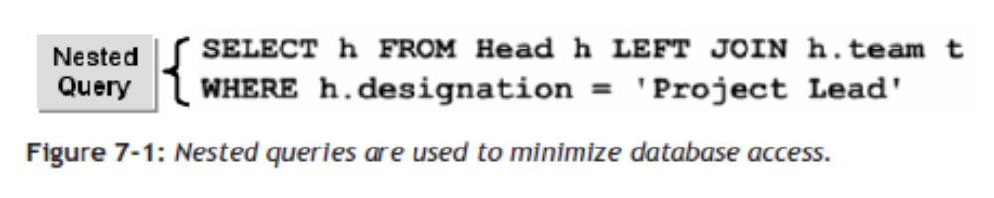
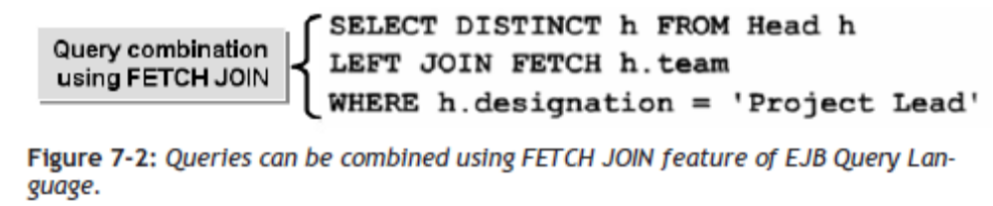
Query Combination
One way of minimizing database access is query combination. This can be done by using nested or inner queries as much as possible. Queries can also be combined by using the FETCH JOIN feature of EJB Query Language.

Slide 20
The Nested Query
Nested queries are created using the JOIN operator to traverse over relationships between entities.
SELECT h FROM Head h LEFT JOIN h.team t
WHERE h.designation = ‘Project Lead’
Notes:
Instructor Notes:
Nested queries are created using the JOIN operator to traverse over relationships between entities. Consider two tables, Head and Team, where Head contains team heads and Team contains team members. They have a relationship: Team Head and Team members. The following query will retrieve data from Head, where designation is equal to Project Lead and they have team members in Team.

Slide 21
The FETCH JOIN Feature
EJB QL supports outer join-based prefetching (termed a FETCH JOIN). A FETCH JOIN for a query returns a result and the prefetched data. This enables bringing in data that an application immediately needs and related data that it will later need.
SELECT DISTINCT h FROM Head h
LEFT JOIN FETCH h.team
WHERE h.designation = ‘Project Lead’
Notes:
Instructor Notes
EJB QL supports outer join-based prefetching (termed a FETCH JOIN). A FETCH JOIN for a query returns a result and the prefetched data. This enables bringing in data that an application immediately needs and related data that it will later need. Prefetching can improve application performance by reducing the database calls that need to be made. Consider two tables, Head and Team, with a relationship of Team Head and Team members. When an application needs information about project leads immediately, and will need information about the team members at a later stage, the following query can be used to select everyone with the designation Project Lead and fetch information about team members.

Slide 22
Update Minimization
Remote calls by entity beans for database updates have a substantial impact on performance. An entity bean with Container Managed Persistence (CMP) can be used to minimize the updates by using relationships (One to One, One to Many, or Many to Many) and updating both the parent and child (bulk) data simultaneously using vendor specific features.

Slide 23
Transaction Scope Minimization
Transaction scope is the number of operations executed and the number of components used. It is necessary to minimize transaction scope during application design or early coding because it requires more container management resulting in limitations and performance cost escalations.

Slide 24
Activity 7-2
Enhancing Database-Level Performance
Scenario:
You are in charge of database administration for your company’s online shopping site. Due to increasing network costs, management has asked you to identify the database-level overheads and minimize them.

Slide 25
Activity 7-2 (1 of 3)
What is the need for caching?
  Read data from read-only tables.
  Reduce the data calls.
  Commit transactions after they are complete.
  Update minimization

Slide 26
Activity 7-2 (2 of 3)
How do you decide on cache sizes?
  Size of the data
  Type of clients
  Frequency of access
  Server used

Slide 27
Activity 7-2 (3 of 3)
True or False? The FETCH JOIN feature of EJB Query Language is used to combine queries.
  True
  False

Slide 28
Module Review
In this lesson, you described site performance enhancement techniques. By enhancing site performance, you ensure that your application runs on several host machines without reduction in performance.
How would you control network overheads at your workplace?
When would you use a local interface rather than a remote interface?
Notes:
Instructor Notes:
In this lesson, you described site performance enhancement techniques. By enhancing site performance, you ensure that your application runs on several host machines without reduction in performance.
How would you control network overheads at your workplace?
Answers will vary.
When would you use a local interface rather than a remote interface?
Answers will vary.

Slide 29
Course Follow-up
In this course, you successfully created applications that use session, entity, and message driven EJBs. You also explored methods of making your applications more robust and efficient. Given these skills, you are now able to create and deploy your own applications using EJBs.
Keeping in mind the EJB applications that you have developed in this class, in what types of applications would you consider using EJBs?
Back at work, in your application development environment, what do you feel will be the biggest advantage that EJB applications will provide?
How will you ensure security and data integrity in an EJB application?
Notes:
Instructor Notes:
In this course, you successfully created applications that use session, entity, and messagedriven EJBs. You also explored methods of making your applications more robust and efficient. Given these skills, you are now able to create and deploy your own applications using EJBs.
Keeping in mind the EJB applications that you have developed in this class, in what types of applications would you consider using EJBs?
Answers will vary, depending on the types of applications with which the student is familiar.
Back at work, in your application development environment, what do you feel will be the biggest advantage that EJB applications will provide?
Answers will vary but may include portability, ease of development, annotations, and code reuse.
How will you ensure security and data integrity in an EJB application?
Answers will vary.

Slide 30
Module Summary
Having completed this module, you should be able to:
Enhance bean-level performance.
Enhance database-level performance.

Slide 31

Congratulations!
Congratulations for completing this module!
Thanks for your participation!

